Slide 1


Mathematics
12 weeks of 3 in 3
Autumn Year 6
Commissioned by The PiXL Club Ltd.
July 2019
This resource is strictly for the use of member schools for as long as they remain members of The PiXL Club. It may not be copied, sold nor transferred to a third party or used by the school after membership ceases. Until such time it may be freely used within the member school.
All opinions and contributions are those of the authors. The contents of this resource are not connected with nor endorsed by any other company, organisation or institution.
PiXL Club Ltd endeavour to trace and contact copyright owners. If there are any inadvertent omissions or errors in the acknowledgements or usage, this is unintended and PiXL will remedy these on written notification.
© Copyright The PiXL Club Limited, 2019

Slide 2

Teachers’ Notes
The purpose of this resource is to develop various aspects of test technique, e.g. working at pace and selecting efficient methods, as well as developing understanding of different question types.
Whilst most of the content is from the Year 6 curriculum, questions also include content from Years 3, 4 and 5. This should assist in identifying any gaps in prior learning.
The questions are presented in the style of the DfE KS2 tests, so that pupils become familiar with the format.
The intention is that pupils complete the three questions in three minutes.
The first two challenges model typical questions from the arithmetic paper.
The third challenge is modelled on typical questions from the reasoning paper (which can be answered relatively quickly).
In addition to giving the solutions (which drop down in a fourth box), a discussion on the strategies used is advised. It is important that pupils develop quick decision making as to whether to solve the arithmetic questions mentally, with a few jottings or by using a standard written method. There is also merit in discussing the requirements of different question types and strategies to support pupils in answering them, e.g. teaching the process of elimination as a strategy for answering multiple choice questions.
For questions such as ‘Tick two’ or ‘Circle the number’, it is suggested that pupils record it in their books or on a whiteboard, so that they are practising the format of these question types; the adult can then identify where the question type may be a barrier to learning.

Slide 3

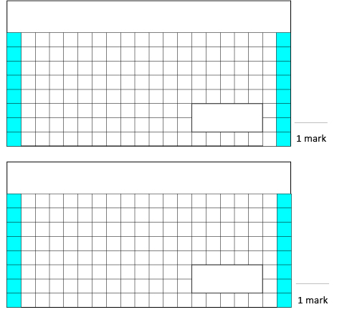

Week 1
3. Write the following number in digits:
Thirty four thousand, two hundred and seven.
1.
2,635 + 286.3 =
2.
3 x 8 x 4 =
Solutions
2,921.3
96
34,207

Slide 4
Week 2
1.
0.7 x 6 =
3. Calculate the following, leaving your answer in Roman Numerals.
MMCIV – MDIX = __________
2.
___________ = 5,000 + 40
Solutions
4.2
5,040
DXCV

Slide 5

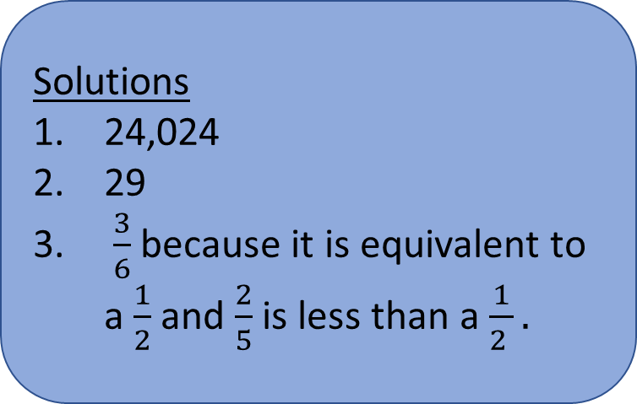
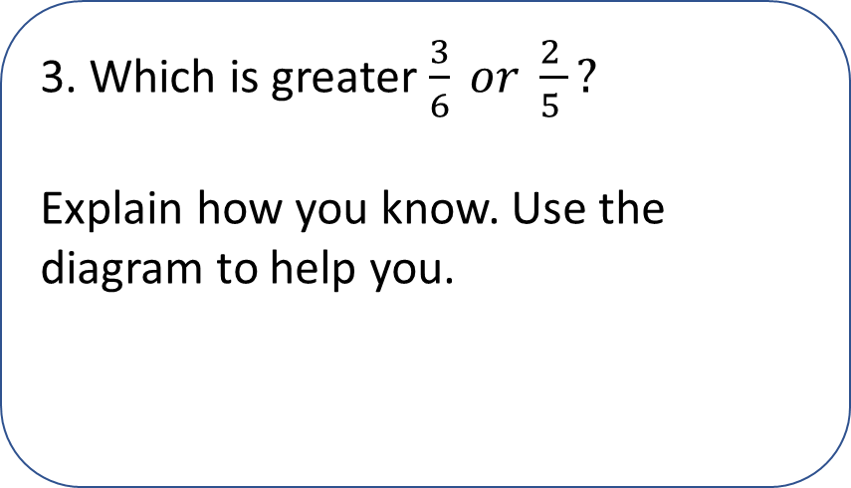
Week 3
3. Which is greater $\frac{3}{6} or \frac{2 }{5 }?$
Explain how you know. Use the diagram to help you.
1.
3,432 x 7 = __________
Solutions
24,024
29
$\frac{3}{6}$ because it is equivalent to a $\frac{1}{2}$ and $\frac{2}{5}$ is less than a $\frac{1}{2 }.$
2.
___________ = 2² + 3² + 4²

Slide 6

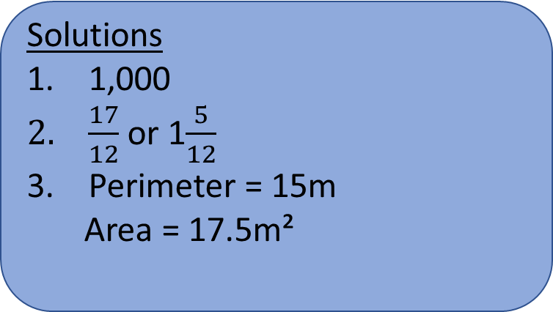
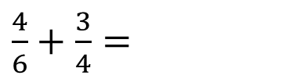
Week 4
3. Calculate the perimeter and area of this shape.
1.
1.34 x ______ = 1,340
2m
2m
Not drawn to scale
1m
5m
3m
3m
5m
2.
$\frac{4}{6}+\frac{3}{4}=$
Solutions
1,000
$\frac{17}{12}$ or 1$\frac{5}{12}$
Perimeter = 15m
Area = 17.5m²

Slide 7

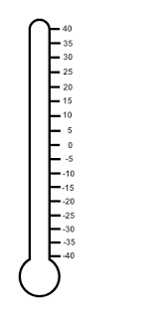
Week 5
3. The thermometers below show the temperatures of a greenhouse at different times during the day. How much hotter is the temperature (°c) at 2:00pm than 10:00 am?
1.
231 x 0 =
10:00am
2:00pm
2.
6 + 9 x 3 =
Solutions
0
33
35°c

Slide 8
Week 6
3. Amy finds a 3-D shape in her attic. She describes it to her brother. “It has 5 faces and some of them are triangular.”
Which two shapes could she be describing?
1.
1,788 ÷ 6 =
Solutions
298
300 + 0
Rectangular/square-based pyramid or triangular prism.
2.
1,307 = 1,000 + + + 7

Slide 9
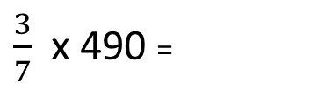
Week 7
3. Sanjeet collects festival wristbands. He has 4 green wristbands for every 3 blue wristbands.
Sanjeet has 18 blue wristbands. How many green wristbands does he have?
1.
25% x 2,300 = __________
2.
$\frac{3}{7}$x 490 =
Solutions
575
210
24 green wristbands

Slide 10

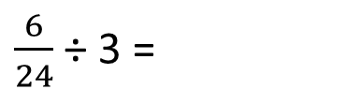
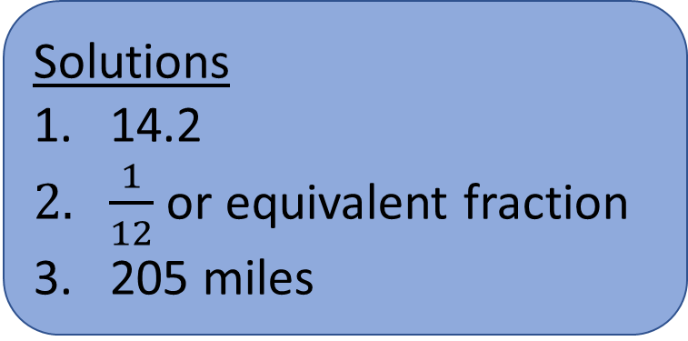
Week 8
1.
142 x 10 = ______ x 100
3. 8 km = 5 miles
Aiden needs to travel 328 km to attend his sister’s birthday party.
How far does Aiden need to travel in miles?
2.
$\frac{6}{24}$ ÷ 3 =
Solutions
14.2
$\frac{1}{12}$ or equivalent fraction
205 miles

Slide 11

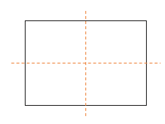
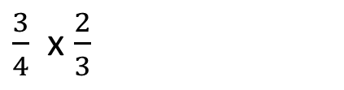
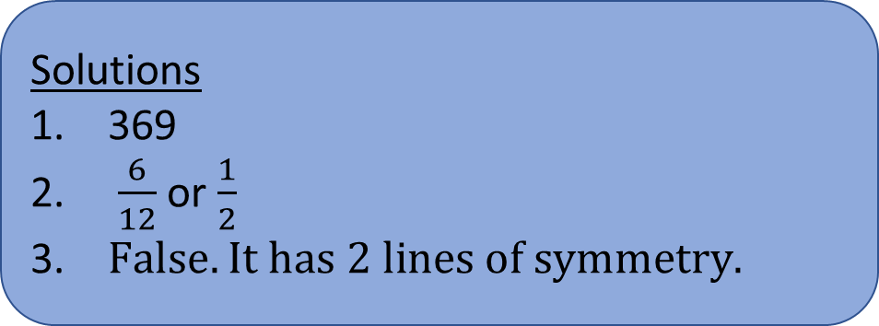
Week 9
3. This rectangle has 4 lines of symmetry.
True or false?
Explain how you know.
1.
8,487 ÷ 23 = _______
Solutions
369
$\frac{6}{12}$ or $\frac{1}{2}$
$False. It has 2 lines of symmetry.$
2.
$\frac{3}{4}$ x $\frac{2}{3}$

Slide 12
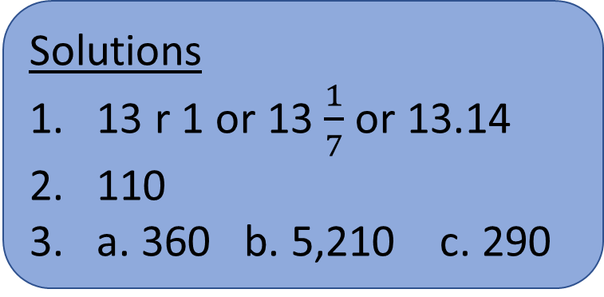
Week 10
3. Round the following numbers to the nearest ten:
363
5,209
290.4
1.
92 ÷ 7 = ________
2.
1,210 ÷ 11 = ________
Solutions
13 r 1 or 13 $\frac{1}{7}$ or 13.14
110
a. 360 b. 5,210 c. 290

Slide 13
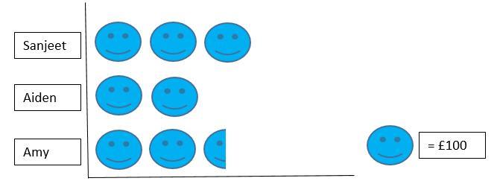
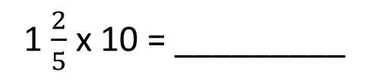
Week 11
3. Sanjeet, Aiden and Amy are saving money to buy tickets for a concert. The tickets cost £300 each.
How much more money do they need to save altogether?
n.
1.
1 $\frac{2}{5}$ x 10 = _________
2.
3³ - 2³ = __________
Solutions
14
19
£150

Slide 14

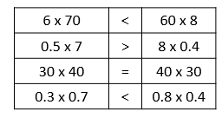
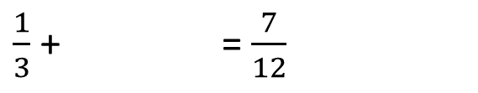
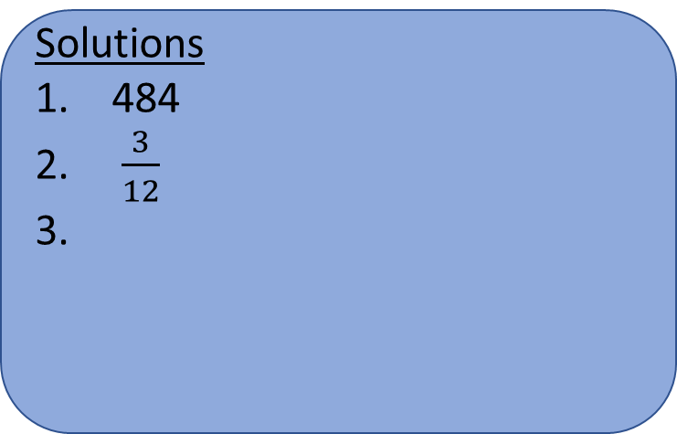
Week 12
3. Insert < > or = in the following calculations.
1.
22 x 22 = ________
6 x 70 |  | 60 x 8
0.5 x 7 |  | 8 x 0.4
30 x 40 |  | 40 x 30
0.3 x 0.7 |  | 0.8 x 0.4
Solutions
484
$\frac{3}{12}$
2.
$\frac{1}{3}$ + = $\frac{7}{12}$

