Slide 1


Mathematics
12 weeks of 3 in 3
Year 6
Commissioned by The PiXL Club Ltd.
January 2019
This resource is strictly for the use of member schools for as long as they remain members of The PiXL Club. It may not be copied, sold nor transferred to a third party or used by the school after membership ceases. Until such time it may be freely used within the member school.
All opinions and contributions are those of the authors. The contents of this resource are not connected with nor endorsed by any other company, organisation or institution.
PiXL Club Ltd endeavour to trace and contact copyright owners. If there are any inadvertent omissions or errors in the acknowledgements or usage, this is unintended and PiXL will remedy these on written notification.
© Copyright The PiXL Club Limited, 2018

Slide 2
Teachers’ Notes
The purpose of this resource is to develop various aspects of test technique, e.g. working at pace and selecting efficient methods, as well as developing understanding of different question types.
Whilst most of the content is from the Year 6 curriculum, questions also include content from Years 3, 4 and 5. This should assist in identifying any gaps in prior learning.
The questions are presented in the style of the DfE KS2 tests, so that pupils become familiar with the format.
The intention is that pupils complete the three questions in three minutes.
The first two challenges model typical questions from the arithmetic paper.
The third challenge is modelled on typical questions from the reasoning paper (which can be answered relatively quickly).
In addition to giving the solutions (which drop down in a fourth box), a discussion on the strategies used is advised. It is important that pupils develop quick decision making as to whether to solve the arithmetic questions mentally, with a few jottings or by using a standard written method. There is also merit in discussing the requirements of different question types and strategies to support pupils in answering them, e.g. teaching the process of elimination as a strategy for answering multiple choice questions.
For questions such as ‘Tick two’ or ‘Circle the number’, it is suggested that pupils record it in their books or on a whiteboard, so that they are practising the format of these question types; the adult can then identify where the question type may be a barrier to learning.

Slide 3
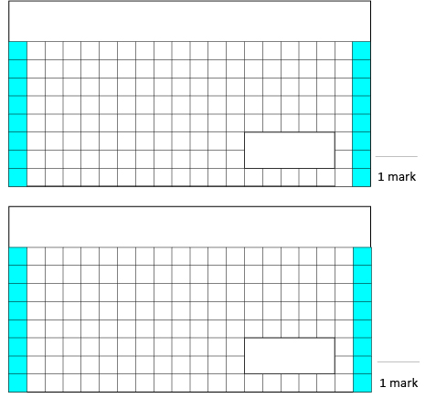
Week 1
1.
0.8 X 7 =
3. Put these numbers in ascending order.
123,546 123,456 1,123,645 132,456
_____ _____ _____ _____
2.
_______ = 55,000 – 8,000
Solutions
5.6
47,000
123,456 123,546 132,456 1,123,645

Slide 4
Week 2
1.
_______ = 3² + 4³
3. There are 12 children at Paul’s birthday party. Paul’s mum gives them all a drink of juice. Each glass contains 275ml. Paul’s mum has 4 litres of juice. How much juice will she have left?
2.
53 x 48 =
Solutions
73
2,544
700ml / 0.7l

Slide 5
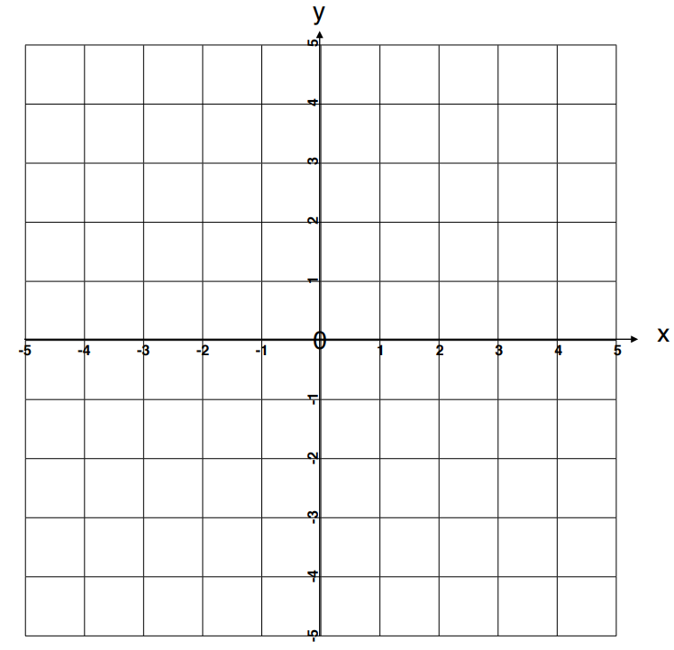
Week 3
Here is a coordinate grid with three vertices of a rectangle drawn on it. What are the coordinates of the fourth vertex?
1.
50.27 ÷ 10 =
2.
________ = 604,293 – 56,107
Solutions
5.027
548,186
(-2,-3)

Slide 6
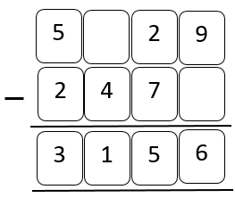
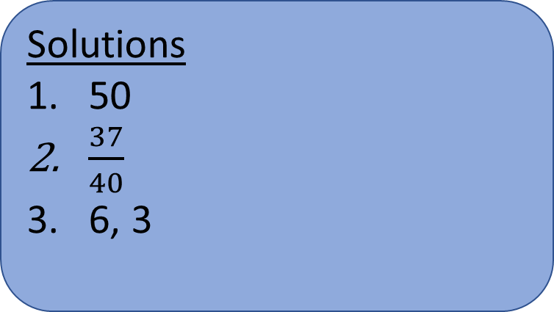

Week 4
3. Write the two missing digits to make this subtraction calculation correct.
1.
600 x ______ = 30,000
2.
$\frac{4}{5}+\frac{1}{8}=$
Solutions
50
$\frac{37}{40}$
6, 3
6
3

Slide 7
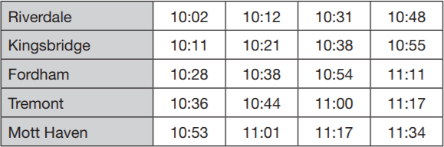
Week 5
3. Here is part of the bus timetable from Riverdale to Mott Haven.
How long does it take for the 10:48 bus from Riverdale to reach Mott Haven?
1.
1,386 ÷ 9 =
2.
203.42 – 56.11 =
Solutions
154
147.31
46 minutes

Slide 8
Week 6
3. Erin says, “A triangle has 2 obtuse angles and 1 acute angle.”
Is she correct? Yes or No?
Explain how you know.
1.
______ = 375 x 46
Solutions
17,250
55
No – the angles in a triangle add up to 180° but obtuse angles have to be bigger than 90 each, so there would be no third vertex.
2.
28 + 3 x 9 =

Slide 9
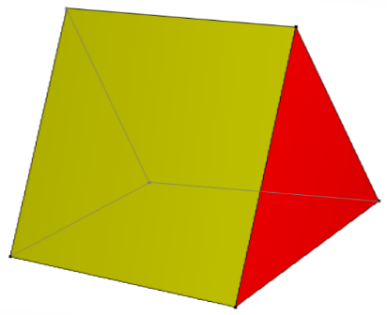

Week 7
3. Here is a drawing of a 3D shape.
Complete the sentences.
There are _________ faces.
There are _________ vertices.
There are _________ edges.
1.
______ = 27,568 + 4,391
2.
$\frac{3}{9}$ x 270 =
Solutions
31,959
90
5 faces, 6 vertices, 9 edges

Slide 10

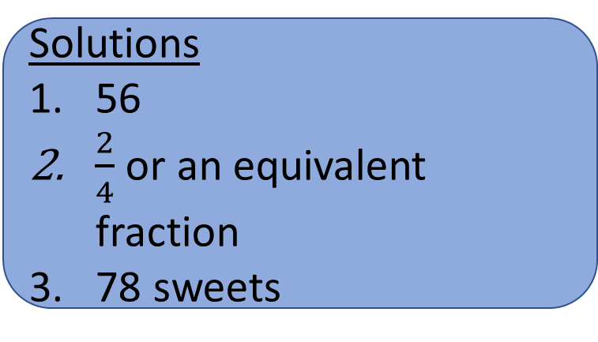
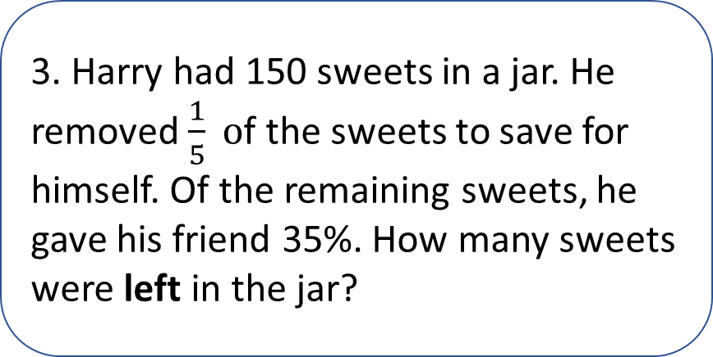
Week 8
1.
108 - ____ = 26 x 2
3. Harry had 150 sweets in a jar. He removed $\frac{1}{5} o$f the sweets to save for himself. Of the remaining sweets, he gave his friend 35%. How many sweets were left in the jar?
2.
$\frac{6}{4}$ ÷ 3 =
Solutions
56
$\frac{2}{4}$ or an equivalent fraction
78 sweets

Slide 11
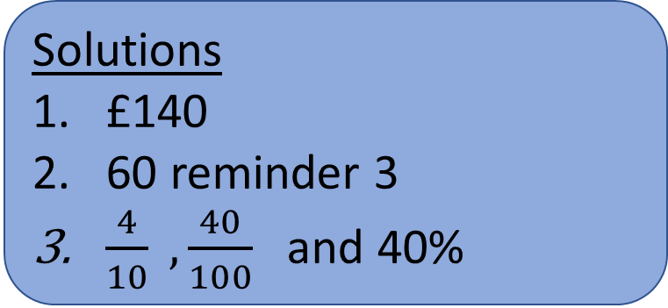
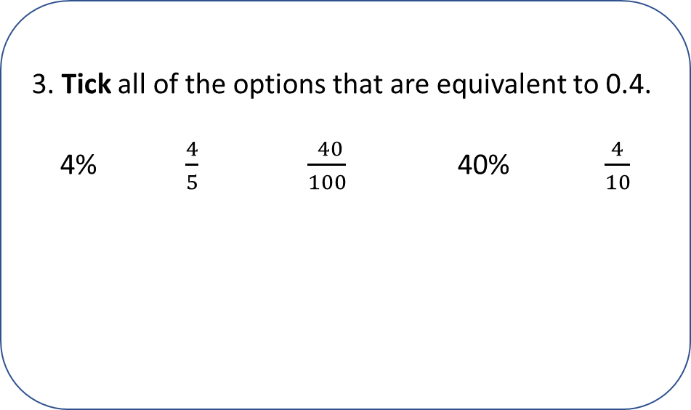
Week 9
3. Tick all of the options that are equivalent to 0.4.
4% $\frac{4}{5}$ $\frac{ 40}{100} \text{40\%}$ $\frac{4}{10}$
1.
______ = 35% of £400
2.
843 ÷ 14 =
Solutions
£140
60 reminder 3
$\frac{4}{10} , \frac{40}{100}$and 40%

Slide 12
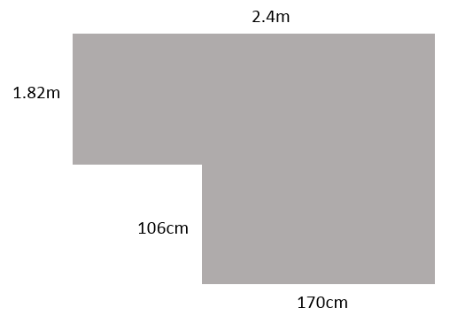

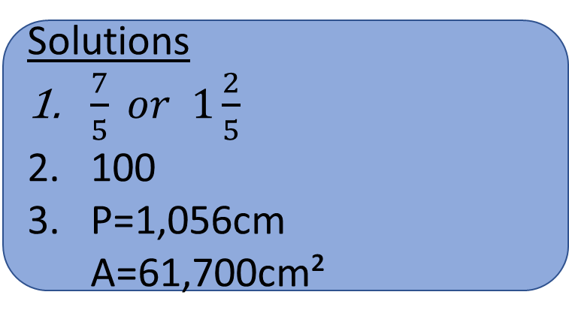
Week 10
3. Calculate the perimeter and area of this shape.
1.
$2\frac{1}{5}$ - $\frac{4}{5}$ =
2.
72.9 x _____ = 7,290
Solutions
$\frac{7}{5} or 1\frac{2}{5}$
100
P=1,056cm A=61,700cm²

Slide 13
Week 11
1.
0.9 x ____ = 900
3. Paula bought bags of crisps in a range of flavours. For every 4 bags of crisps she bought, 3 were salt and vinegar. Altogether she had 18 packs of salt and vinegar. How many bags of crisps did Paula buy?
2.
4,863 x 29 =
Solutions
1,000
141,027
24

Slide 14

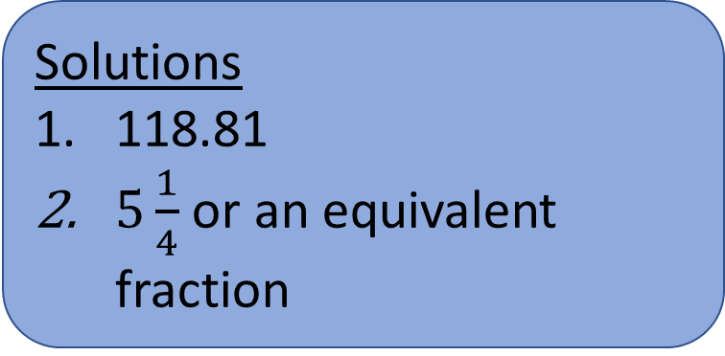
Week 12
3. On the next slide.
1.
157.5 – 38.69 =
Solutions
118.81
$5\frac{1}{4}$ or an equivalent fraction
2.
_____ = $\frac{7}{8}$ x 6

Slide 15
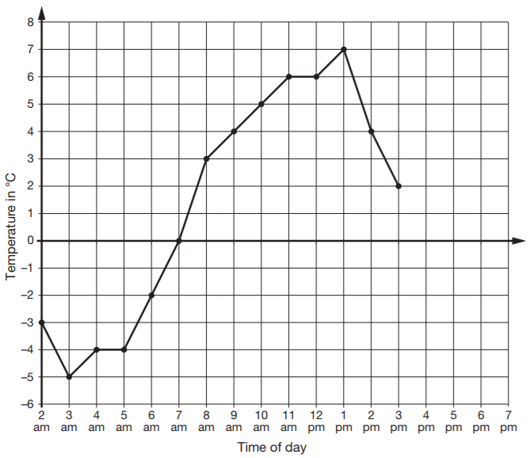
Week 12
3. This graph shows the temperature from 2am to 3pm on a cold day.
How many degrees warmer was it at 1pm than at 6am?
b) At 9pm the temperature was 6 degrees warmer than at 3am. What was the temperature at 9pm?
Solution
3a. 9°
3b. 1°C

